Slide 1
INTRODUCTION TO .NET

Slide 2
What will be Covered
What is computer programming
Different types of application
How computer programs Works
Introduction to .NET Framework
.NET Framework Architecture and components
Introduction to C# Programming Language
How to Download and install Visual studio
First console application

Slide 3
What is Computer Programming
A language is a way to communicate with each other. It involves exchanging a set of instruction from one person to another.
A computer language is also a set of instructions that the computer can understand, it’s a formal language used to communicate with a computer.
We need to communicate with computers too in order for it to help us do complex computations (e.g. the factorial of 100). But the problem is that a computer understands Binary language(o’s and 1’s) and we human understands different languages (i.e. English, Chinese ).
If we want to talk to the computer we should pass instructions in machine code or binary code but do we understand binary code

Slide 4

If you want to pass instruction to a computer you need to learn a programming language like C, C++, Java , JavaScript and C# (high-level programming languages)
So to communicate we write programs using any programming language , so we have to study the language first and write programs ( which is just a set of instructions) but we don’t yet have machine Code?
Programs get converted by the compiler and generate machine code and not the computer can receive input and provide output.

Slide 5
Types of Programming Languages
Machine Language – This is the language that the computer understands, it involves a series of binary 0’s and 1’s
Assembly Language – This is a low-level programming language but easier than machine language( used to develop OS)
High-level Languages- the low-level programming languages are hard to learn so we wanted some English-like language so high-level programming languages were introduced like : C, C++,C#,JS , Java and Python.
Problem-oriented Languages – this include SQL
Natural languages – mainly used in Artificial intelligence

Slide 6
Introduction to the .NET Framework
NET stands for Network Enabled Technology (Internet). In .NET, dot (.) refers to Object-Oriented, and NET refers to the internet. So, the complete .NET means through Object-Oriented we can implement internet-based applications.
According to Microsoft, .NET is a Free, Cross-Platform, Open-Source developer platform for building many different types of applications. With .NET, we can use multiple languages (C#, VB, F#, etc.), Editors (Visual Studio, Visual Studio Code, Visual Studio for Mac, OmniSharp, JetBrains Rider, etc.), and Libraries to build for Web, Mobile, Desktop, Games, IoT, and more.
Cross Platform: Whether you are working in C#, F#, or Visual Basic, your code will run on any compatible operating system. You can build many types of apps with .NET. Some are Cross-Platform, and some target a specific set of operating systems and devices.
Libraries: To extend functionality, Microsoft and others maintain a healthy .NET package ecosystem. NuGet is a package manager built specifically for .NET that contains over 100,000 packages.

Slide 7
What Does the .NET Framework Provide
The .NET framework provides two component:
BCL (Base Class Libraries)
CLR (Common Language Runtime)
What is BCL
The Base Class Library is installed when we install the .NET framework . It provides a set of API’s and types for common functionality e.g. types for string, date, numbers
BCL is a collection of pre-written code that provides many useful tools and building blocks form programmers when they are building their programs .
(toybox)

Slide 8
What is the CLR
CLR is the execution engine that handles running applications, it provides services like garbage collection, threading , exception handling and more.
Its main work is to ensure that the programs you write in the .NET framework works properly.( babysitter)
CLR Consist of a JIT compiler which is responsible for executing the Intermediate Code into Byte Code.
The garbage collector manages the allocation and release of memory for an application. Therefore, developers working with managed code don’t have to write code to perform memory management tasks. Automatic memory management can eliminate common problems such as forgetting to free an object and causing a memory leak or attempting to access freed memory for an object that’s already been freed.

Slide 9
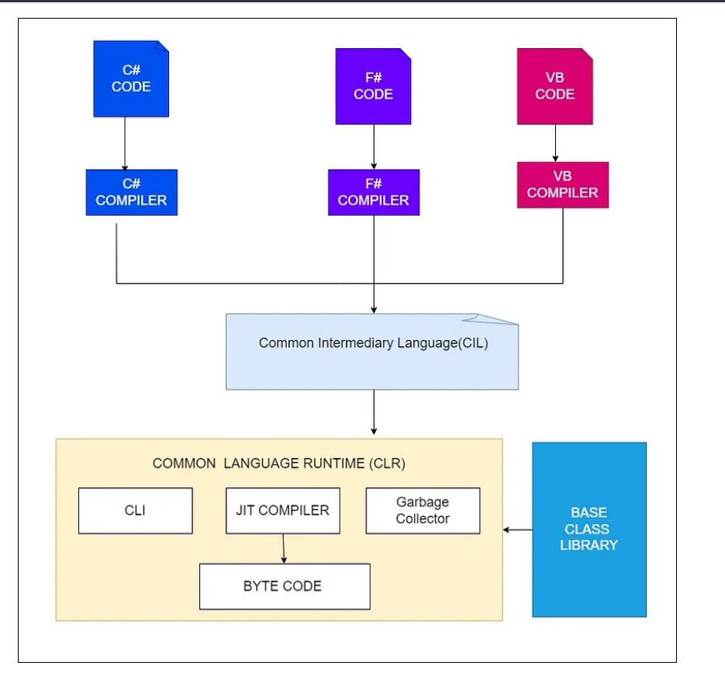
C# Code Compilation and Execution

Slide 10
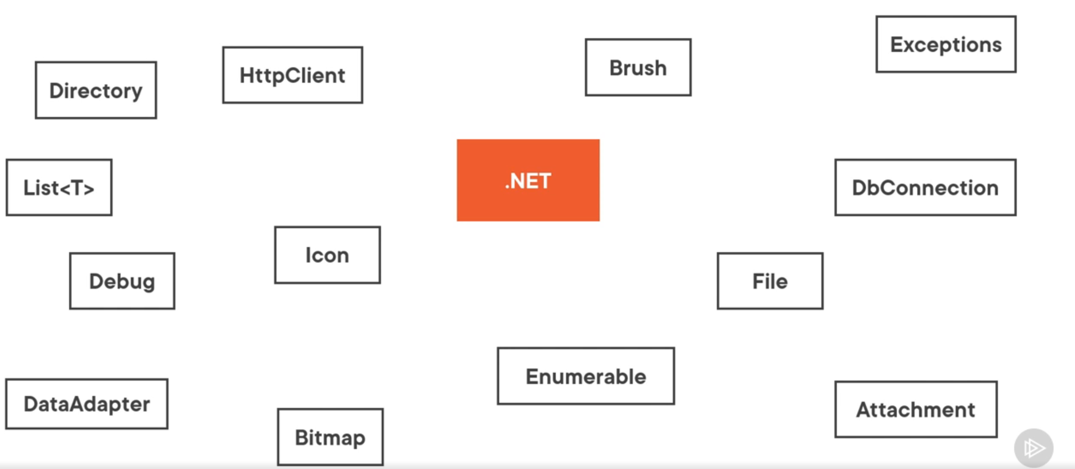

Slide 11
In the .NET framework, the code is compiled twice.
In the 1st compilation, the source code is compiled by the respective language compiler and generates the intermediate code which is known as MSIL (Microsoft Intermediate Language) or IL (Intermediate language code), or Managed Code.
In the 2nd compilation, MSIL is converted into Native code (native code means code specific to the Operating system so that the code is executed by the Operating System) and this is done by CLR inside the JIT compiler
Always 1st compilation is slow and 2nd compilation is fast.

Slide 12
CLR Features
Memory Management: The CLR automatically manages memory allocation and garbage collection, which helps prevent memory leaks and ensures efficient memory usage.
Security: The CLR provides a secure execution environment for .NET applications, with features like code access security and verification.
Just-in-Time (JIT) Compilation: The CLR compiles .NET code to machine code at runtime, which helps improve performance by optimizing code based on the current system and environment.
Cross-Language Interoperability: The CLR supports multiple programming languages, and allows code written in different languages to work together seamlessly.
Exception Handling: The CLR provides a robust exception handling mechanism that helps developers handle errors and exceptions more easily.
Debugging: The CLR includes tools for debugging .NET applications, making it easier for developers to identify and fix issues in their code.
Threading: The CLR provides a multi-threading environment that allows applications to take advantage of multiple processors or cores, improving performance and scalability.

Slide 13
Different Types of the .NET Framework
.NET Framework: .NET Framework is the original implementation of .NET. It supports running websites, services, desktop applications, and more on Windows OS Only.
.NET: .NET is a cross-platform implementation for running websites, services, and console applications on Windows, Linux, and macOS. .NET is open source on GitHub and .NET was previously called .NET Core.
Xamarin/Mono: Xamarin/Mono is a .NET implementation for running apps on all the major mobile operating systems, including iOS and Android.

Slide 14
What is Exactly .NET?
.NET is a framework tool that supports many programming languages and many technologies. .NET support 60+ programming languages. Of 60+ programming languages,11 are designed by Microsoft and the remaining are designed by non-Microsoft. Microsoft-designed programming languages are as follows:
VB.NET
C#.NET
VC++.NET
J#.NET
F#.NET
Jscript.NET
WindowsPowerShell
Iron phyton
Iron Ruby

Slide 15
History Time
Before C# there were tow languages in the C family :c and c++.
When we compiled code with any of the above the compiler compiled our code to native code for the machine its running on e.g.(windows or macOS)
But we have different hardware's , and that means that the above wont be possible.
C# however changed that

Slide 16
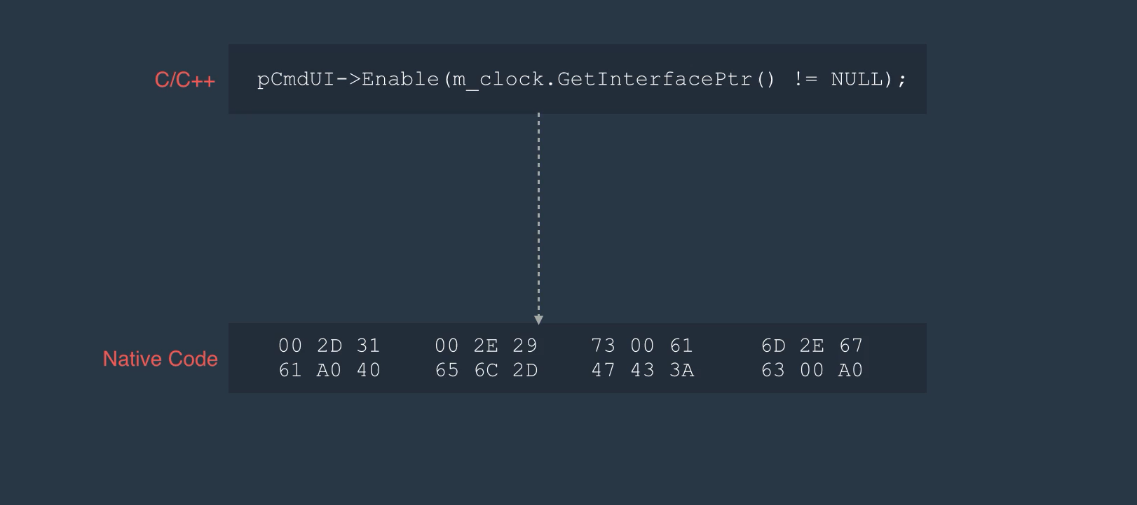


Slide 17
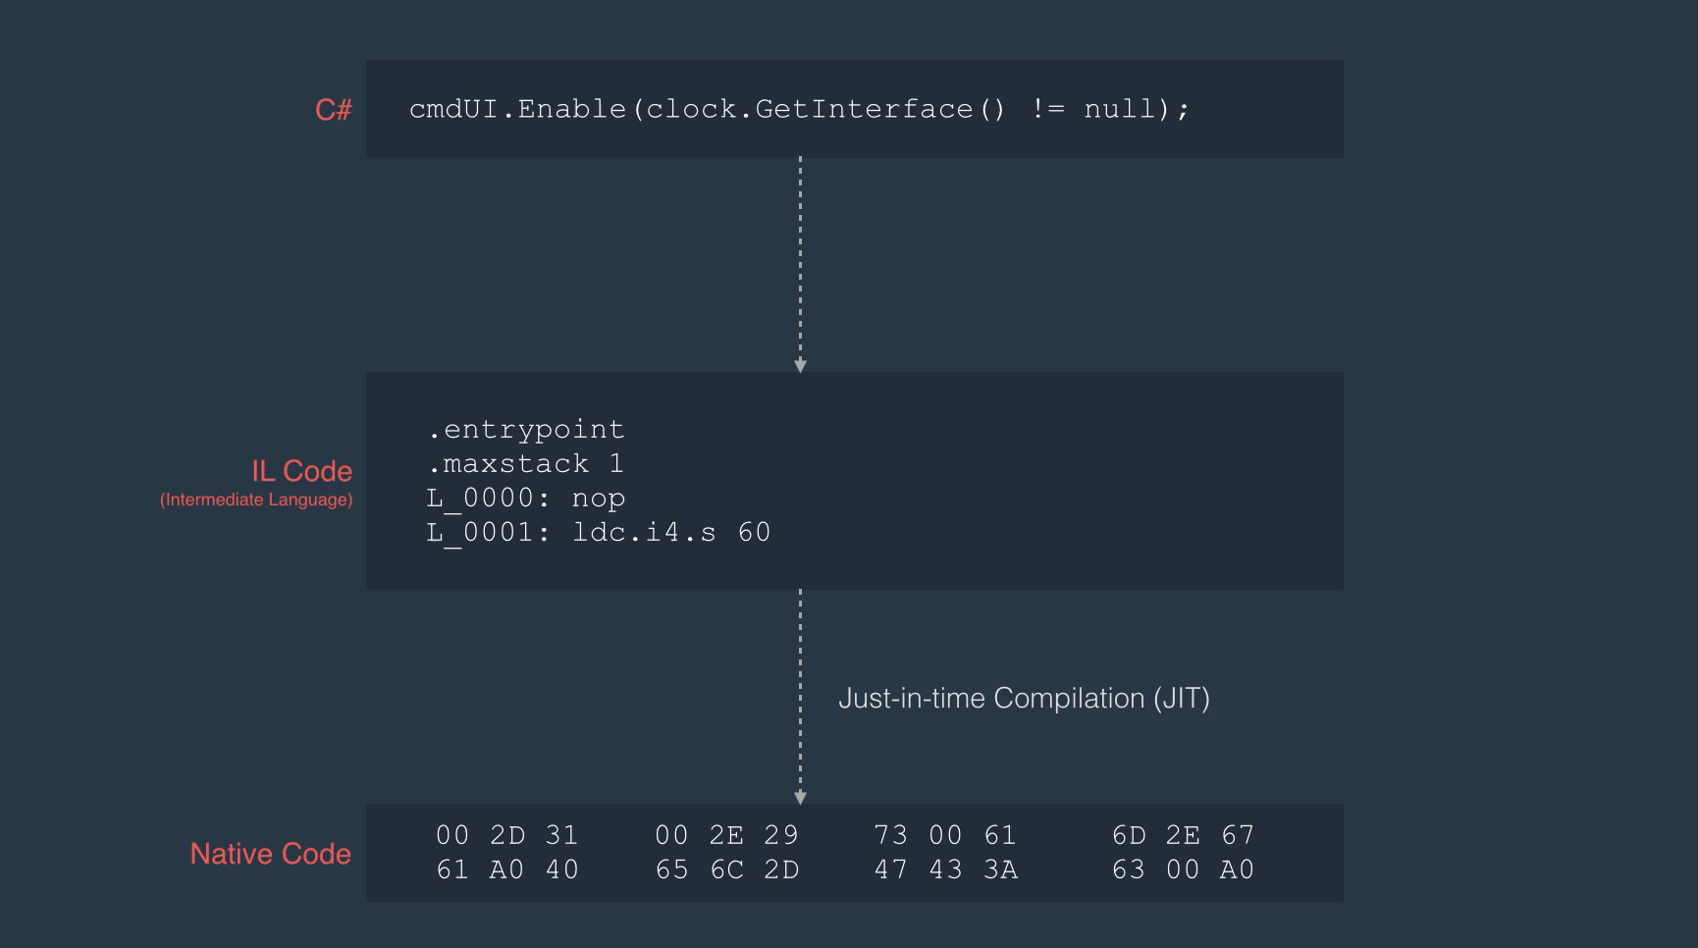

Slide 18
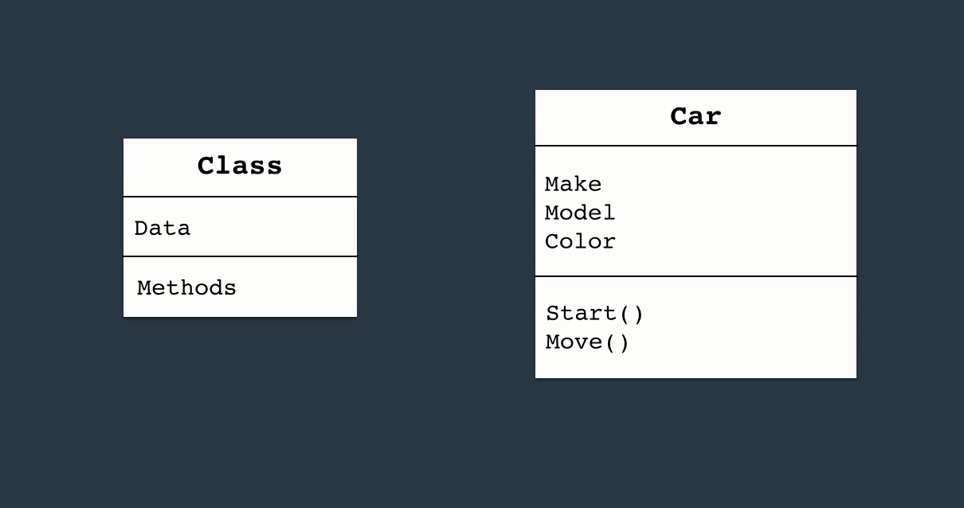
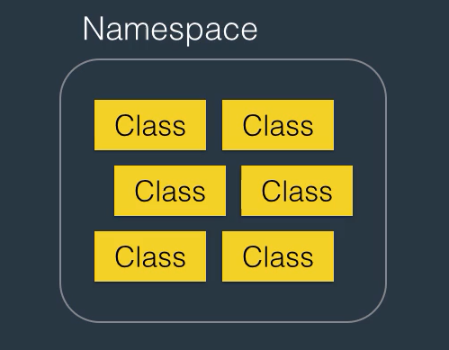
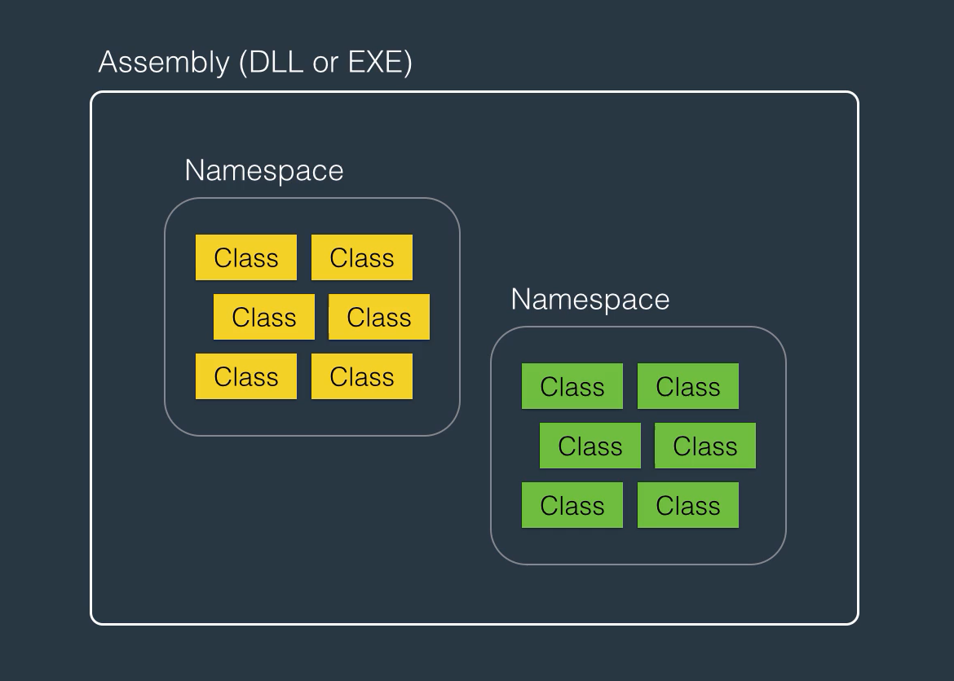
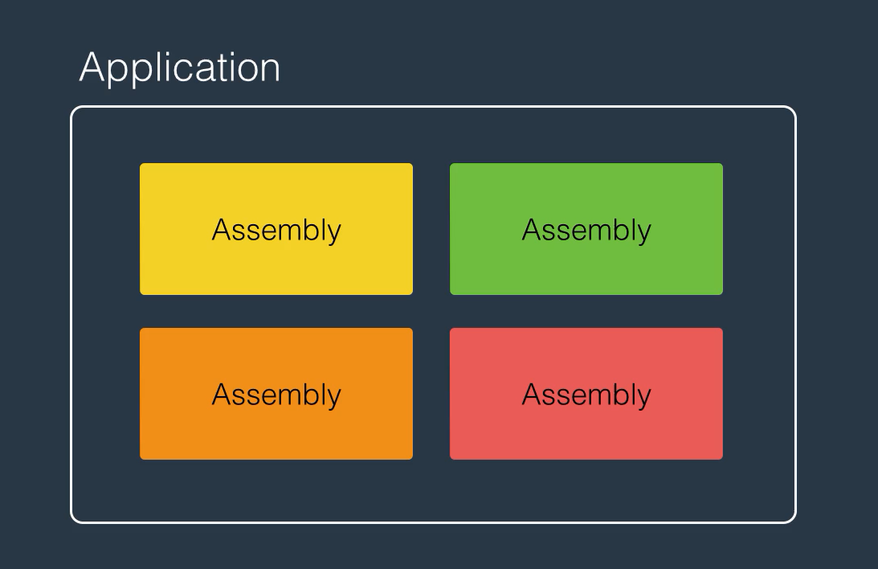
Architecture of C# Application

Slide 19
Why C#
C# is Simple and Familiar:
C# is simple because C# simplifies the programmer’s job by avoiding certain features of C and C++. C# avoids explicit memory management. Memory management in C# is automatic. It is done by CLR. So, there is no chance of memory leakage. There is a pointer concept in C# but it is restricted. C# is very familiar to programmers because it is modeled on the C and C++ languages. C# uses many features of C and C++; therefore, C# codes look like C and C++ codes. We can say C# is the simplified version of C and C++.
C# is Portable:
Portability allows the programmer to write the same code for different machines (operating systems). C# provides portability in two ways
Source Code Portability
IL Code Portability (DLL and EXE)
In C#, we can write the source code in Multiple OS and get the output. Even though we can IL Code Portability is also available. So, once you have the DLL and EXE, then you can use those DLLs and EXEs on different OS and you can get the output as expected. Whereas in the case of C and C++ there is only source code portability.
C# is Robust:
Robust means Strong. C# is a strong type-checking language having strict type-checking during both compilation time and execution time which allows us to develop error-free applications and programs.

Slide 20
C# is Dynamic:
C# 4.0 introduced a new type called dynamic that avoids compile-time type checking. A dynamic type escapes type checking at compile-time; instead, it resolves the type at run time. So, if you don’t know the type of data that you want to store, then you can use dynamic as the data type, and at runtime based on value or data, the type will automatically resolve. So, C# is dynamic.
C# is Platform Independent:
Many Programming Languages are compatible with only one platform. Now, with the introduction of .NET Core or .NET, C# was specifically designed to be platform-independent. C# applications with .NET Core or .NET can be run on Windows, Linux, and Mac operating systems. So, we can say C# is Platform Independent with .NET Core or .NET.
C# is Multithreaded:
A process is divided into several small parts known as threads or lightweight processes. Sending multiple threads to the processor for processing is known as multithreading. Multi-threading means handling multiple tasks simultaneously. For example, we can listen to music while scrolling a page and at the same time we can download an application from the internet on a computer.
If multiple threads are used to execute your application code, then it is called Multithreading. Multithreading is a mechanism to implement Concurrent Programming where multiple threads execute the code simultaneously. And using C# Programming language we can develop multithread applications. So, C# supports multithreaded programming.

Slide 21
C# is Object-Oriented:
Except for the primitive data types, all elements in C# are objects. Object-oriented is not a programming language, it is a programming technique or concept, or principle which defines a set of rules and regulations for organizing the data and instructions. The concepts provided by oops are as follows
Encapsulation
Abstraction
Polymorphism
Inheritance
The Programming Language which supports these four features is known as an Object-Oriented Programming Language. And C# Programming Language supports these four features, so C# is Object-Oriented.
Automatic Memory Management:
The .NET Framework automatically manages memory allocation and de-allocation for objects. When a dot net application runs, lots of objects are created. At a given point in time, it is possible that some of those objects are not used by the application. Garbage Collector in .NET Framework is nothing but a Small Routine or you can say it is a Background Process that runs periodically and try to identify what objects are not being used currently by the application and de-allocates the memory of those objects. So, as a developer, we need not worry about how memory allocation and deallocation are done in .NET Applications.
Exception Handling:
C# Provides Strong Exception Handling Features which can be used to stop the Abnormal Termination of the program and you can also provide user-understandable messages when an exception is raised.

Slide 22
Features of C#
Simple: C# is a simple language in the sense that it provides a structured approach (to break the problem into parts), a rich set of library functions, data types, etc.
Modern Programming Language: C# programming is based upon the current trend and it is very powerful and simple for building scalable, interoperable, and robust applications.
Object-Oriented: C# is an object-oriented programming language. OOPs makes development and maintenance easier whereas in Procedure-oriented programming language it is not easy to manage if code grows as the project size grows.
Type-Safe: C# type safe code can only access the memory location that it has permission to execute. Therefore, it improves the security of the program.

Slide 23
Interoperability: The interoperability process enables the C# programs to do almost anything that a native C++ application can do.
Scalable and Updateable: C# is an automatic scalable and updateable programming language. For updating our application, we delete the old files and update them with new ones.
Component Oriented: C# is a component-oriented programming language. It is the predominant software development methodology used to develop more robust and highly scalable applications.
Structured Programming Language: C# is a structured programming language in the sense that we can break the program into parts using functions. So, it is easy to understand and modify.
Rich Library: C# provides a lot of inbuilt functions that make development fast.
Fast Speed: The compilation and execution time of the C# language is fast.

